Slide 1

SSL STRIPPING
NETWORK SECURITY ASSIGNMENT
Name | Roll Number
Subham Netam | IIT2019028
Adelik Om Tyagi | IIT2019070
Nimish Upadhyay | IIT2019113
Ritik Parmar | IIT2019155
Jaidev Das | IIT2019197

Slide 2
What is SSL Stripping?
An SSL stripping attack is a type of cyber attack in which hackers downgrade a web connection from a more secure HTTPS to a less secure HTTP (HTTP and HTTPS are application protocols.)
The attacker intercepts the connection between the victim and the server, and can access all information shared between the two, or becomes the ‘man-in-the-middle’
Moxie Marlinspike, an American computer security researcher, was the one who showed how one can bypass the security provided by HTTPS using this type of attack in 2009.

Slide 3
How does it work?
There is an instance where the Client gets redirected from HTTP to HTTPS.
Attacker intervenes in the redirection and uses this small window of opportunity to intercept connection between Client and Server.
Then Attacker establishes a secure HTTPS connection with Server and an unsecure HTTP connection with Client, hence performing a man-in the-middle attack using SSL stripping.
Now the attacker can access whatever information the client is sending to the server. He then can make an HTTPS request with this information to the server, get the response, and relay it to the client
This way the neither the client, nor the server is aware of the attacker’s interception.

Slide 4
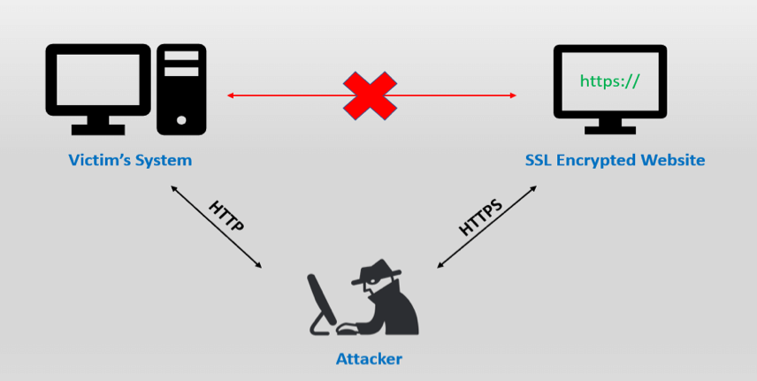
How does it work? (visual)
Source: www.venafi.com

Slide 5
Detection
Check if connection is HTTP or HTTPS (most browsers now show this information on the address bar, if the lock at the left end of the search bar appears open or red, it means the connection is not in HTTPS, and hence insecure)
Checking the authenticity of the site (a slight change in the company logo, lack of multiple pages on the website or spelling errors will let you know that this website is not what you expected)

Slide 6
Prevention
Using HSTS: HTTP Strict Transport Security or HSTS is a policy that ensures websites only allow connections that use HTTPS connections. This prevents attackers from using SSL stripping to connect users to websites through an HTTP connection.
Using VPNs: Virtual private networks or VPNs protect user data on websites regardless of connection type.
Preventing Public Wi-Fi: Public Wi-Fi hotspots, especially airport Wi-Fi hotspots, are ideal for humans in Middle Attacks. Sensitive data can be easily intercepted or the user redirected to malicious websites via public Wi-Fi.
Avoiding unknown links and using only HTTPS: Never click on suspicious links and never accept connections to a website that does not have HTTPS. If a website has an HTTP connection, leave the website.

Slide 7
Conclusion
SSL Stripping is serious threat used by attackers to steal confidential and sensitive data and there are many tools by which we can protect ourselves from this type of attacks such that use of HTTP strict transport security, Use of Virtual Private Networks, Preventing Public Wi-Fi, Unknown links and HTTPS.

